Slide 1
Project Review 2

Slide 2
$tocker
stock market prediction Using machine learning

Slide 3

Logo

Slide 4
What is Machine Learning ?

Slide 5
Machine learning is a growing technology which enables computers to learn automatically from past data. Machine learning uses various algorithms for building mathematical models and making predictions using historical data or information.
In the real world, we are surrounded by humans who can learn everything from their experiences with their learning capability, and we have computers or machines which work on our instructions. But can a machine also learn from experiences or past data like a human does? So here comes the role of Machine Learning

Slide 6
Need of Machine Learning

Slide 7
The need for machine learning is increasing day by day. The reason behind the need for machine learning is that it is capable of doing tasks that are too complex for a person to implement directly. As a human, we have some limitations as we cannot access the huge amount of data manually, so for this, we need some computer systems and here comes the machine learning to make things easy for us.

Slide 8
We can train machine learning algorithms by providing them the huge amount of data and let them explore the data, construct the models, and predict the required output automatically. The performance of the machine learning algorithm depends on the amount of data, and it can be determined by the cost function. With the help of machine learning, we can save both time and money.

Slide 9
The importance of machine learning can be easily understood by its uses cases, Currently, machine learning is used in self-driving cars, cyber fraud detection, face recognition, and friend suggestion by Facebook, etc. Various top companies such as Netflix and Amazon have build machine learning models that are using a vast amount of data to analyze the user interest and recommend product accordingly.

Slide 10
Classification of Machine Learning

Slide 11
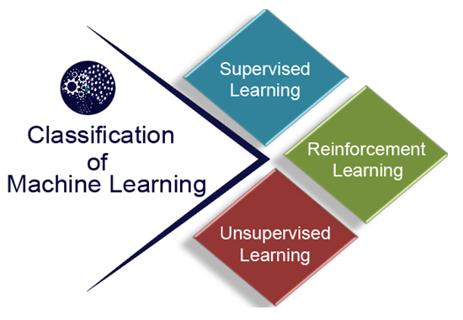

Slide 12
Machine learning Life cycle

Slide 13
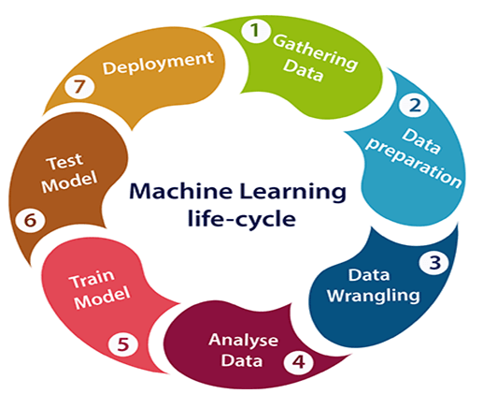

Slide 14
Basics tools for develop ML project
Python version 3.6
Anaconda Navigator
Jupyter book for code deployment

Slide 15
Some important library of python
numpy
datetime
matplotlib
pandas
sklearn
tensorflow
keras

Slide 16
How to get datasets for Machine Learning

Slide 17
Kaggle Datasets
UCI Machine Learning Repository
Datasets via AWS
Google's Dataset Search Engine
Microsoft Datasets
And many more….

Slide 18
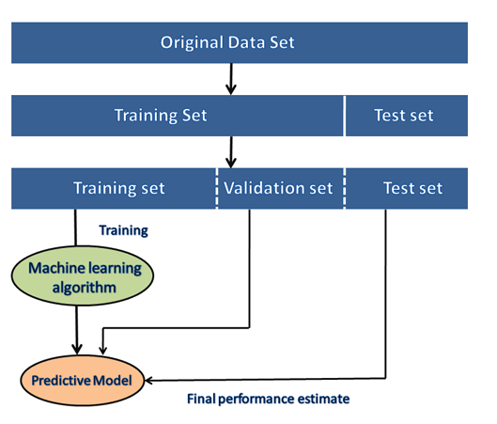
Path to deploy model

Slide 19
Our dataset

Slide 20
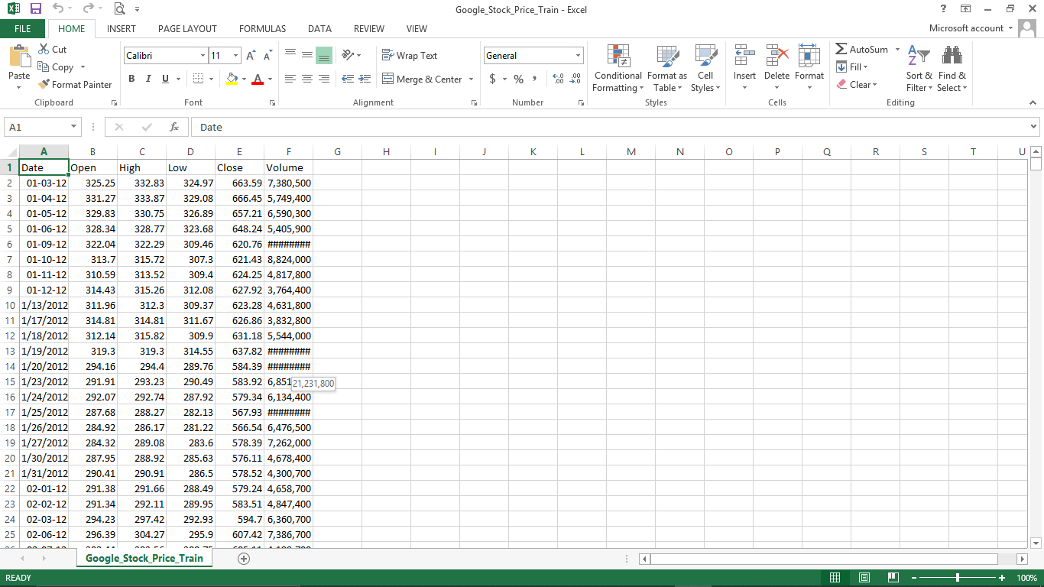

Slide 21
New features of project

Slide 22
Fetching data from API tiingo and store data directly in to system in one csv file using API key
Provide virtual money for those who are new in stock market trading so that can buy virtual stocks on original price
We are thinking to add some API so that can give suggestion like YouTube
We are also thinking to creating pop-up using JS so when that kind of similar stocks are came they got notification

Slide 23
Team
Kanan – 171160107002
She is working on project report
Hetvi – 171160107018
She is working on frontend part(HTML,CSS,JS,Flask)
Pranav – 171160107029
He is working on frontend part as well as contact us page
Brijesh – 171160107052
He is working of ML part and algorithms of ML

Slide 24
Thank you..

